Slide 1

DATA ANALYTICS & NLP – AN INTRODUCTION
- AISWARYA RAMACHANDRAN
This Photo by Unknown Author is licensed under CC BY-SA-NC
This Photo by Unknown Author is licensed under CC BY
This Photo by Unknown Author is licensed under CC BY

Slide 2
Content
AI and Ancient Greece
Evolution Of AI
Big Data & Exponential Growth In AI
Business Transformation in AI Era
Industry Landscape
Careers and Skills
Data Science Framework
Introduction to NLP

Slide 3
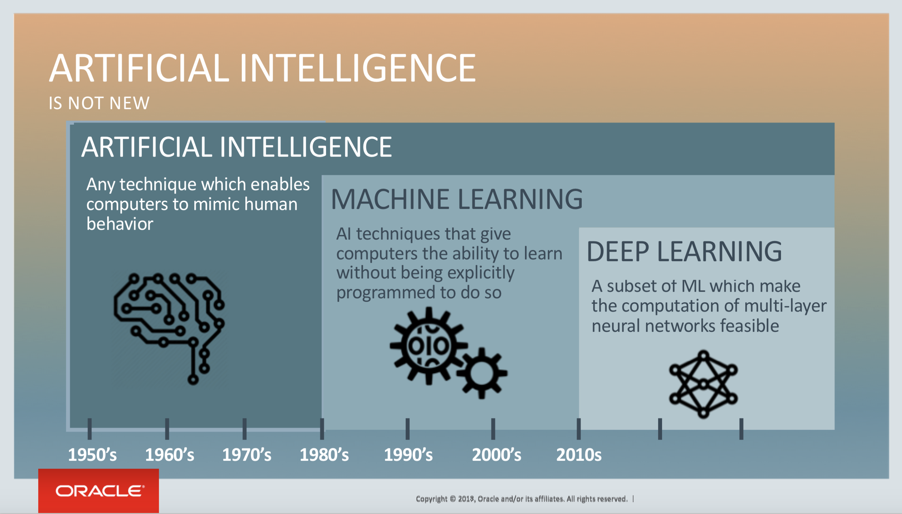

Slide 4
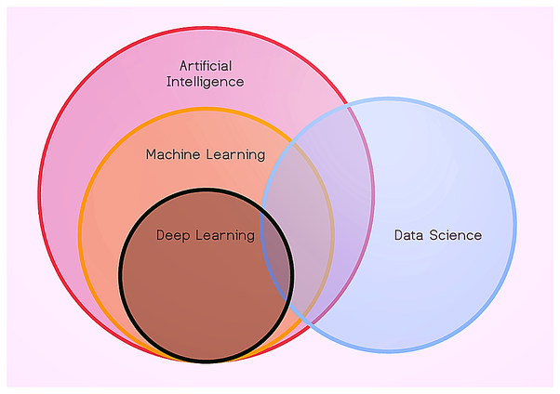
WHAT is DATA SCIENCE?

Slide 5
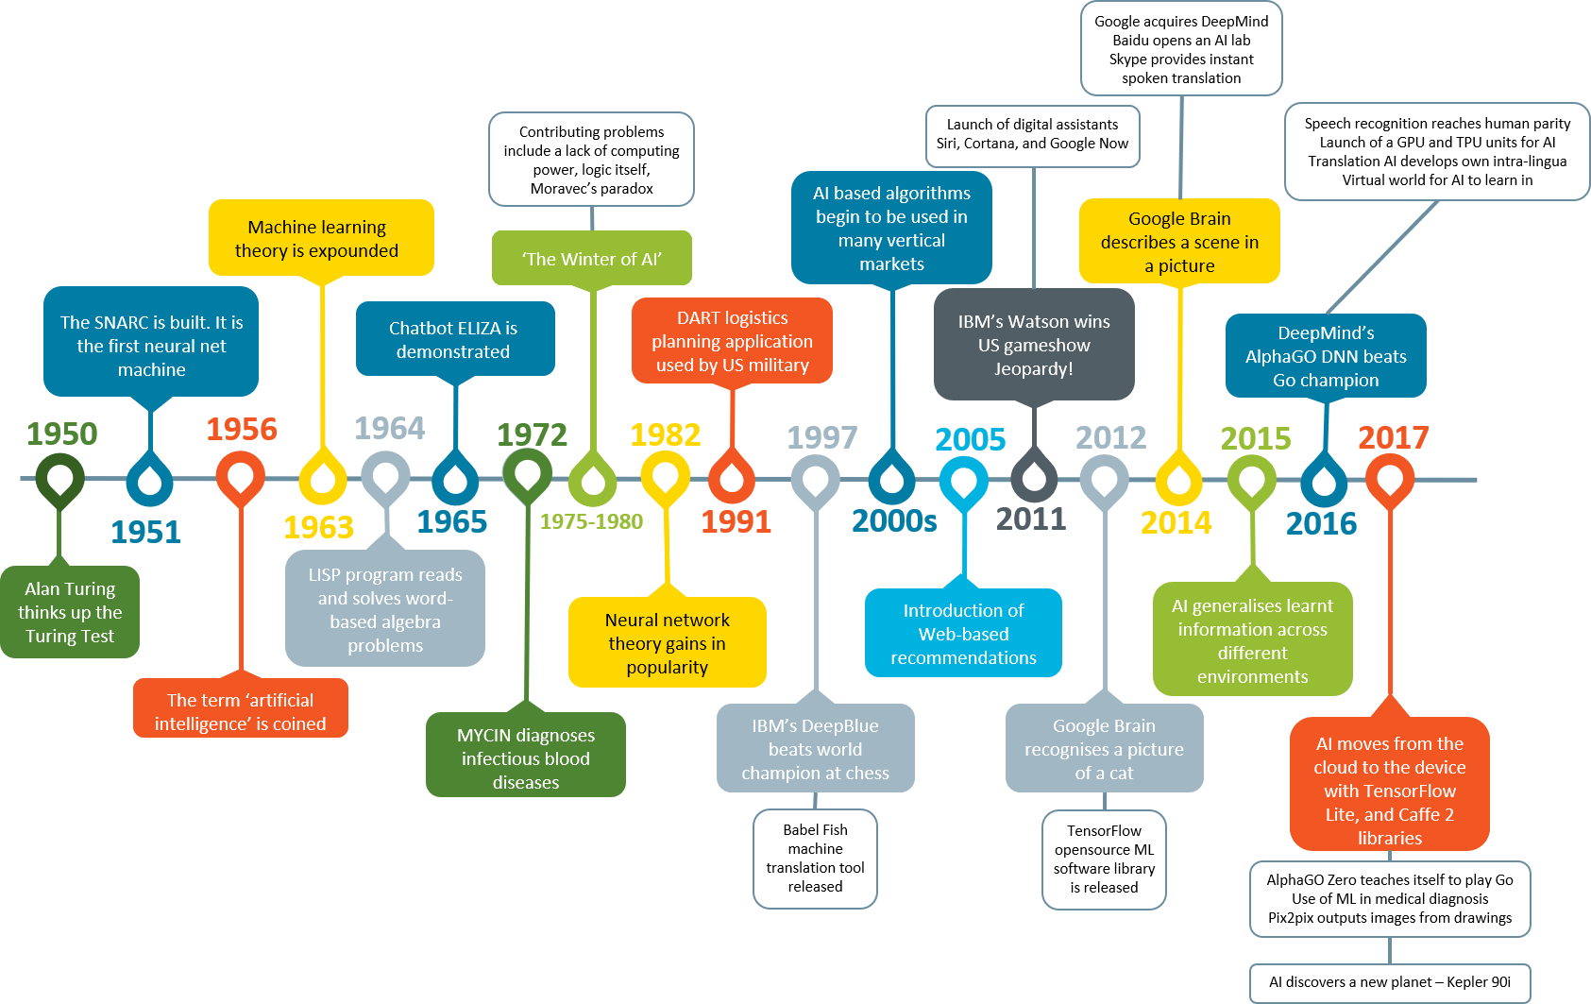
Evolution Of AI – 1950 - 2018

Slide 6

Big Data & Exponential Growth In AI
Maturity
Time
2010

Slide 7
Business Transformation in AI Era
Ecommerce – Recommendation systems, promotions
Banking and Finance – Fraud transaction, Credit Risk, share market prediction, mutual funds
Insurance – Policy making, dynamic pricing
Governance – National Security, calamities and disasters predictions, Sentiment Analysis
Politics – pre and exit pole prediction
Health Care – Clinical Trails
Telecom – Network optimization, tariffs, churning detection
Digital Marketing – Channel optimization, dynamic pricing, COCA
Social Media - Friend suggestion, Vials, Ham and Spam
autonomous vehicles – Google Self Driving Cars
Gaming Industry - xbox

Slide 8
WILL AI TAKE OVER HUMANS- A MYTH or a FACT
ANI (Artificial Narrow Intelligence)
All progress currently have been made in this area
AI can be trained for specific tasks
AGI (Artificial General Intelligence)
This is the ability to apply learning from one domain to another (transfer learning)
Open AI GPT2 is an move in this domain

Slide 9
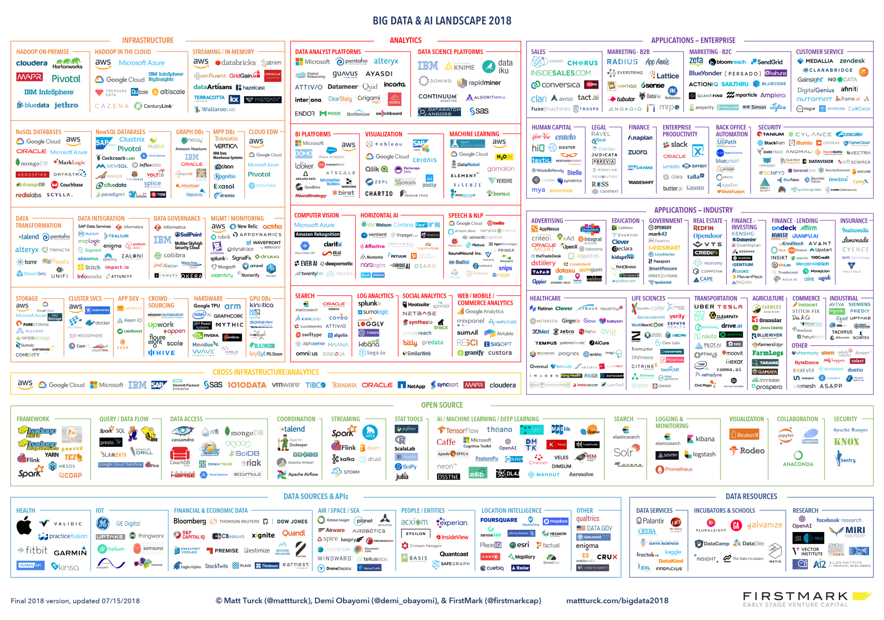

Slide 10
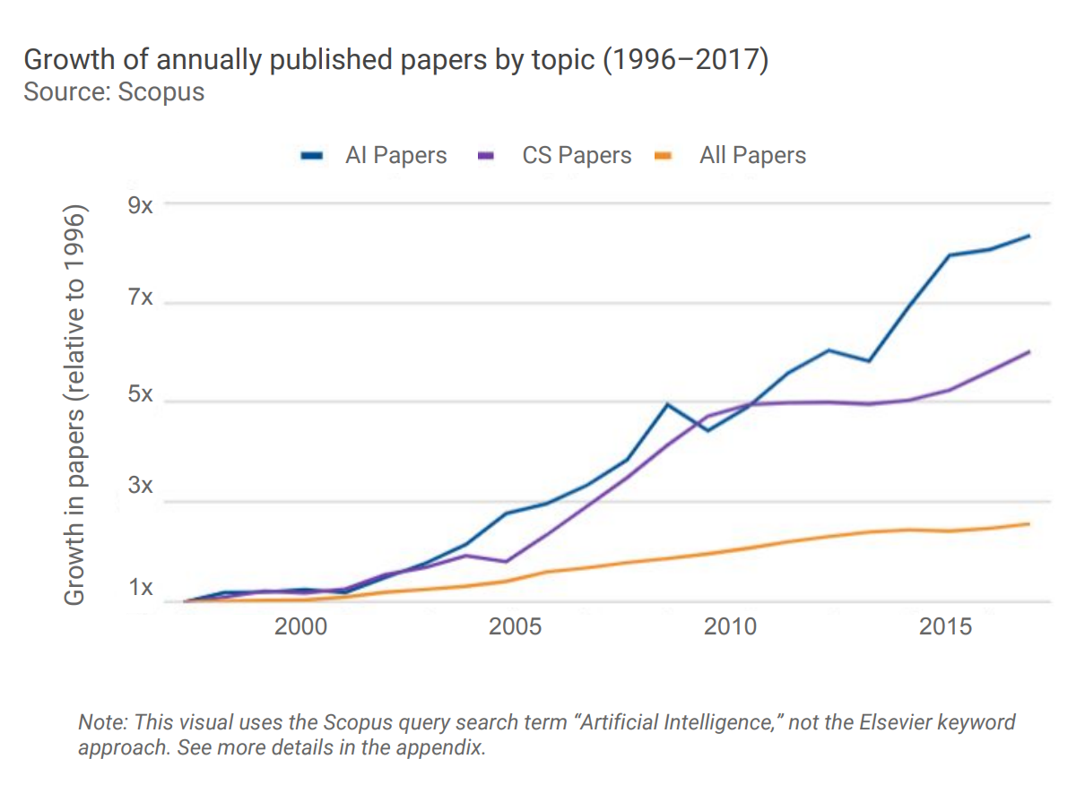
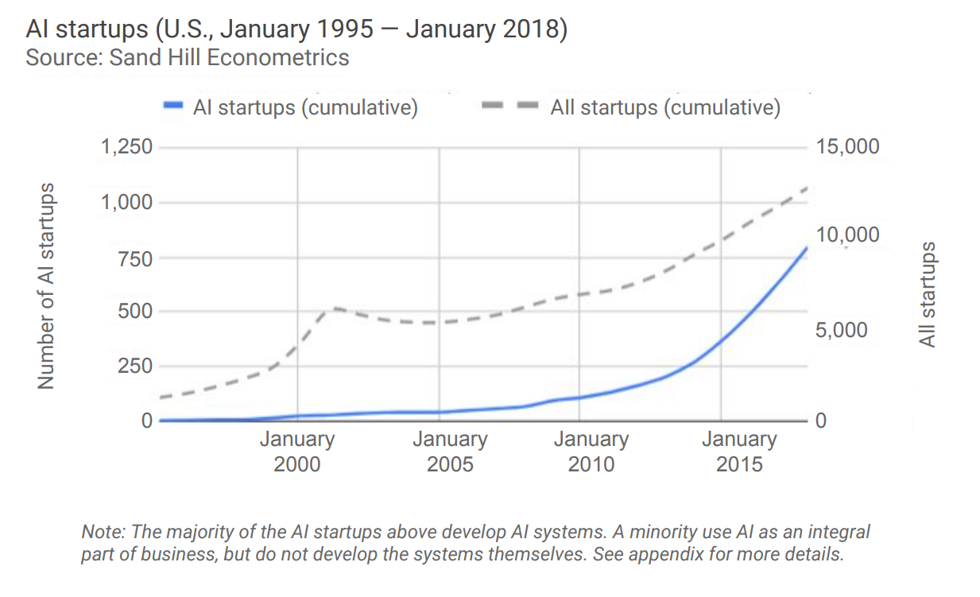
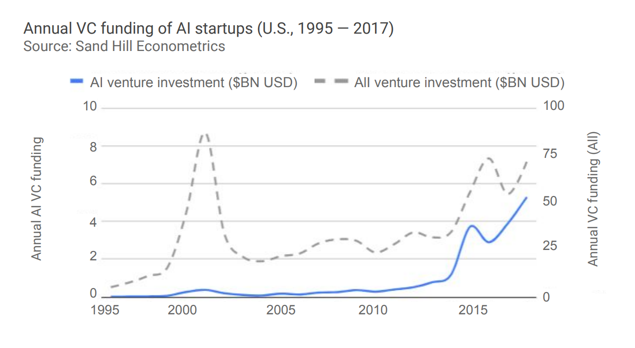
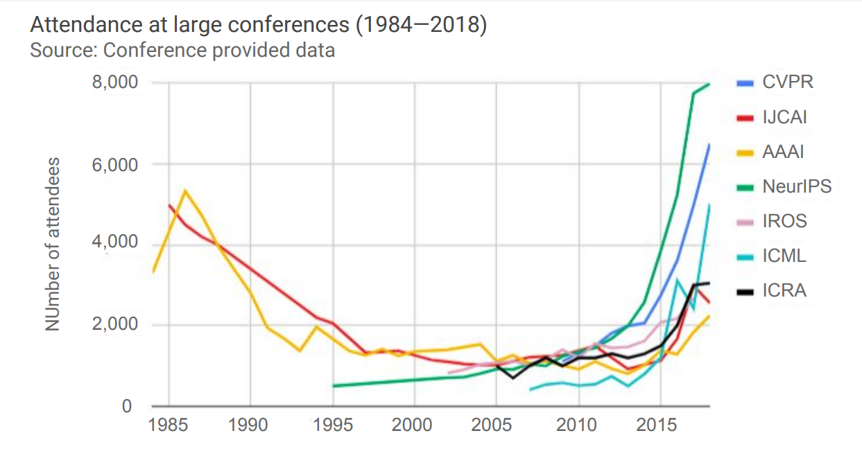
Careers Growth

Slide 11
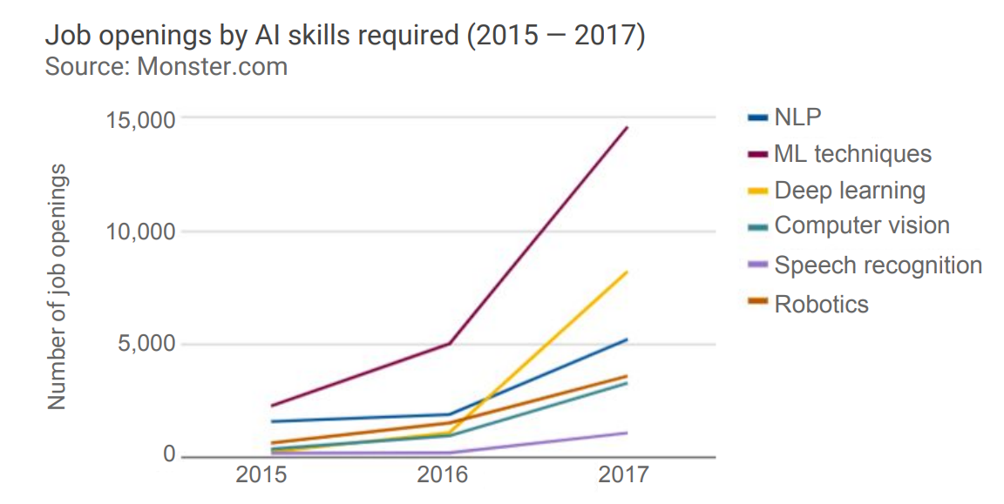
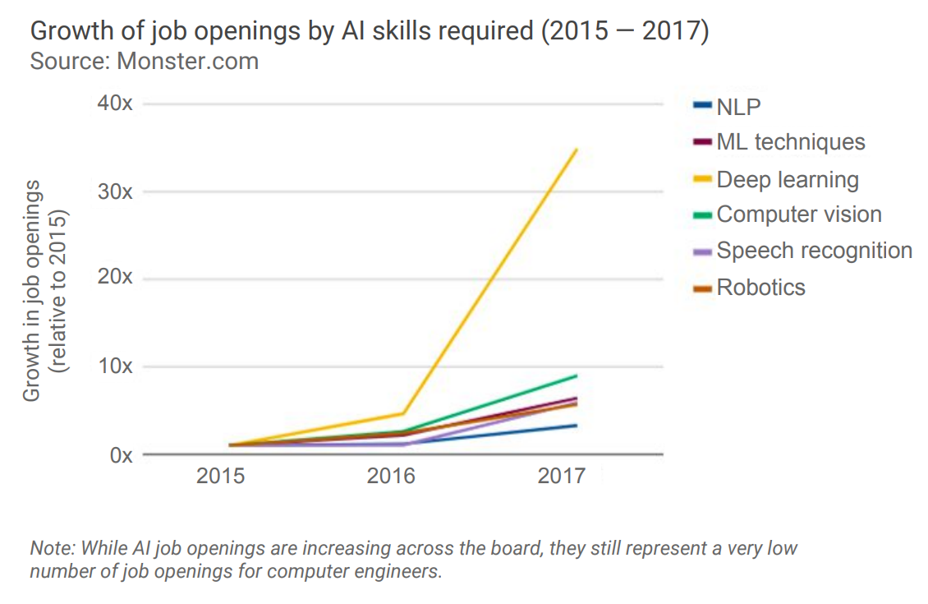
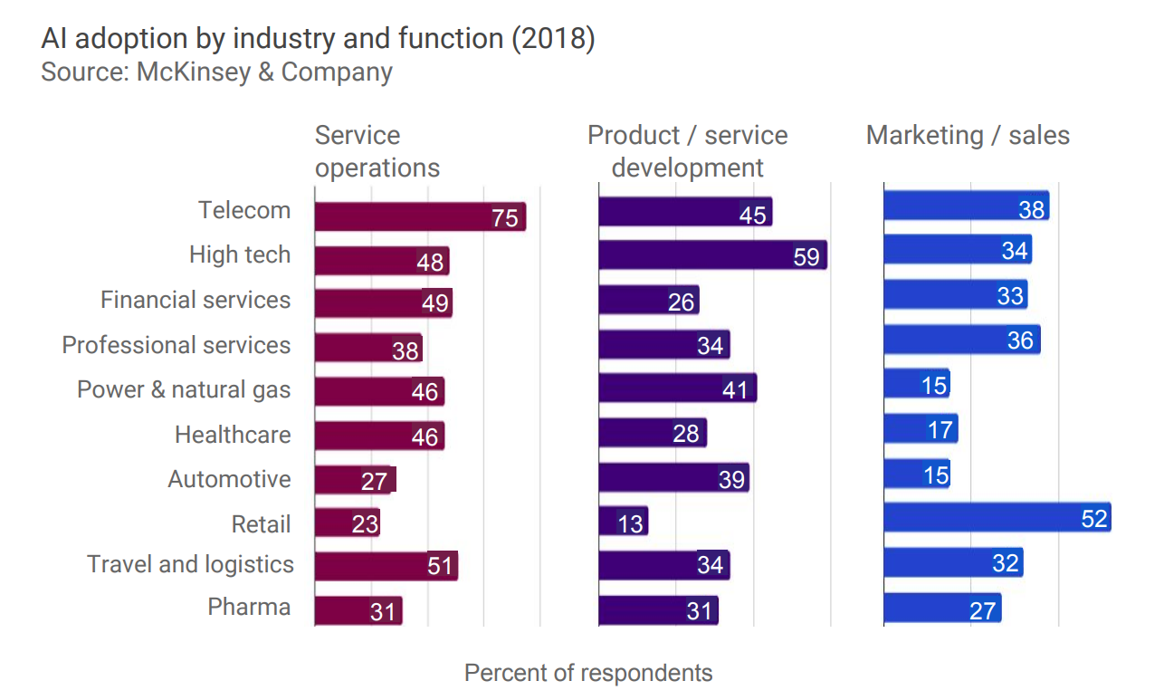
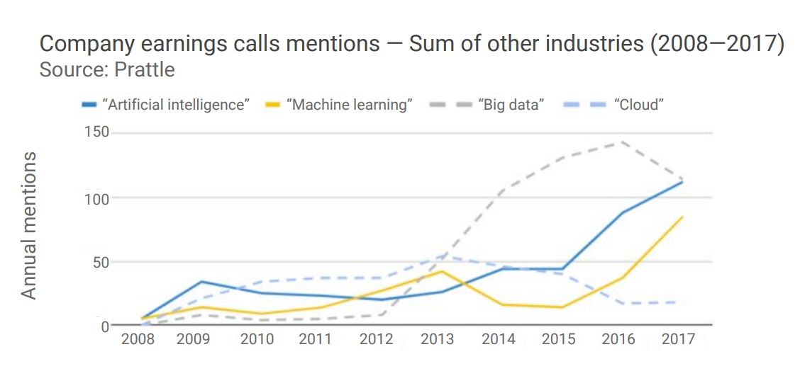
Careers & Skills

Slide 12
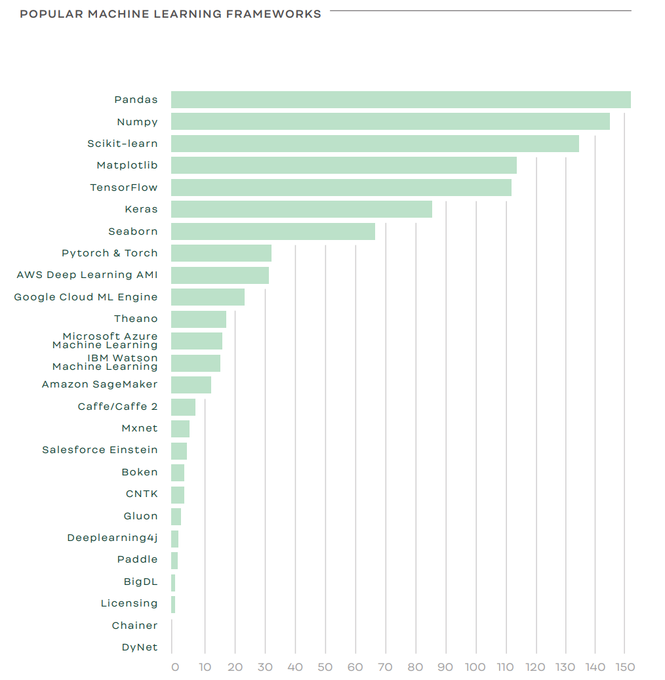
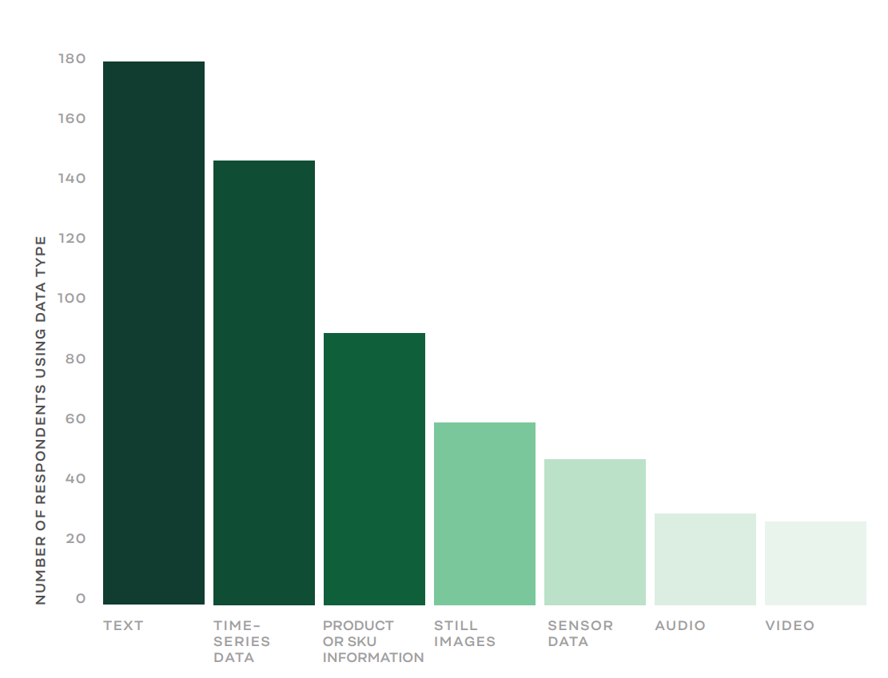
Skills

Slide 13
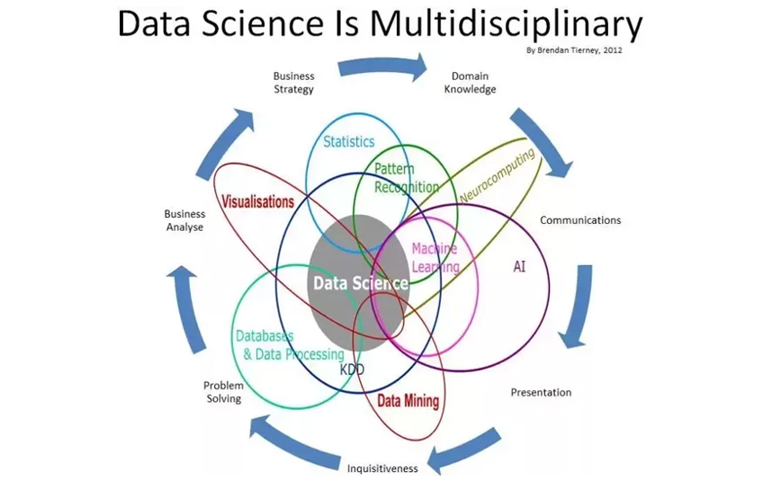

Slide 14
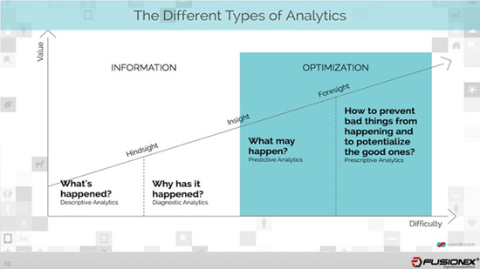

Slide 15
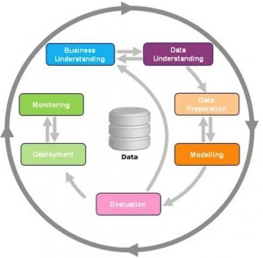
DATA SCIENCE FRAMEWORK 1

Slide 16
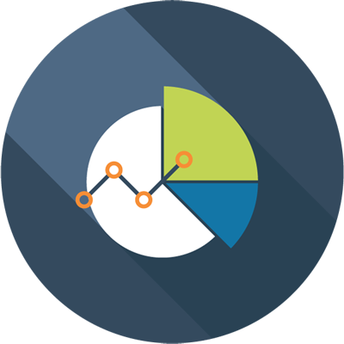
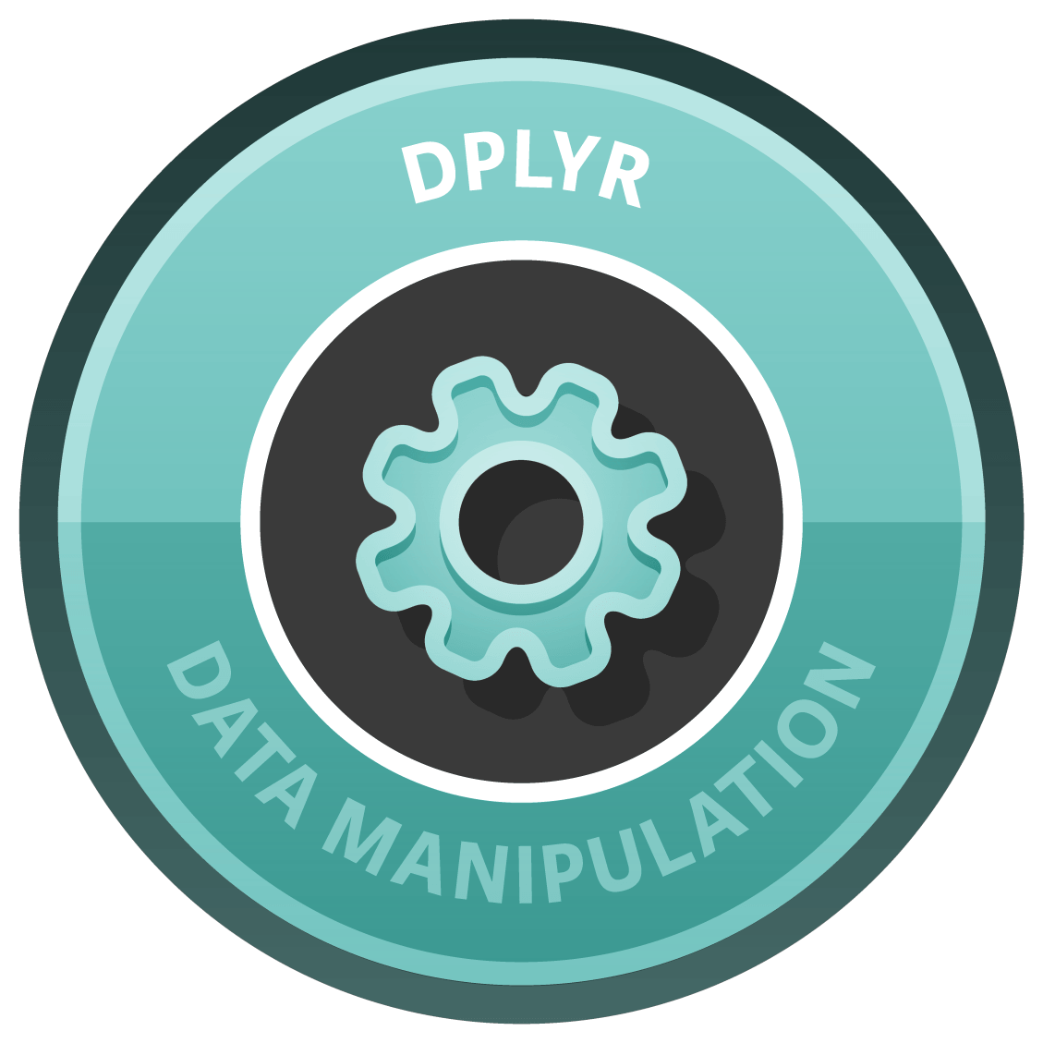




DATA SCIENCE FRAMEWORK 2
Data Visualization
Insights
Data-driven Recommendations
4
Data Manipulation
3
2
Data Cleaning
1
Data Collection

Slide 17
WHAT IS NLP?
Natural Language Processing, is taking these text, analyze and extract the related information in a format that can be used in decision-making capabilities
They help understand human language and queries.
Allows business to understand customer expectations.
For example : “The quality of the battery and the performance is very good but the phone is very heavy”.

Slide 18
WHY is NLP Hard?
Cannot be defined with an explicit set of rules
Natural Language is Ambiguous
For example: The man saw the girl with the telescope.
Same word can mean different things : “river bank” and “nationalized bank”
Lingusitic Structure depends on Slang, Regional Dialects,Social Context etc.

Slide 19
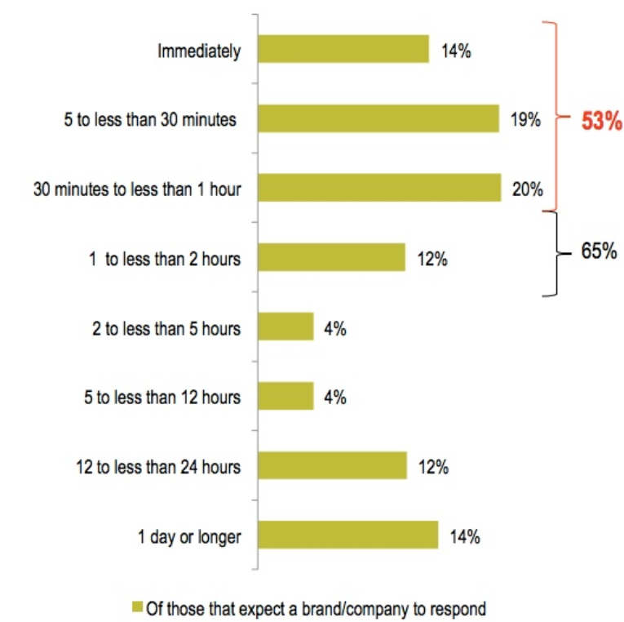
WHY Is NLP Important to BUISNESS?
Most of the data collected today are Text data
Helps understand customers – through reviews, posts on social media
60% of respondents cited negative consequences to the brand if they didn't receive timely Twitter responses
The image source : https://blog.hubspot.com/marketing/twitter-response-time-data

Slide 20
NLP : Areas of APPLICATION
Social Media Analytics
Bank and Loan Processing
Insurance Claim Processing
Customer relationship processing
Security and Counter-terrorism
Computation Social Science
Ecommerce

Slide 21
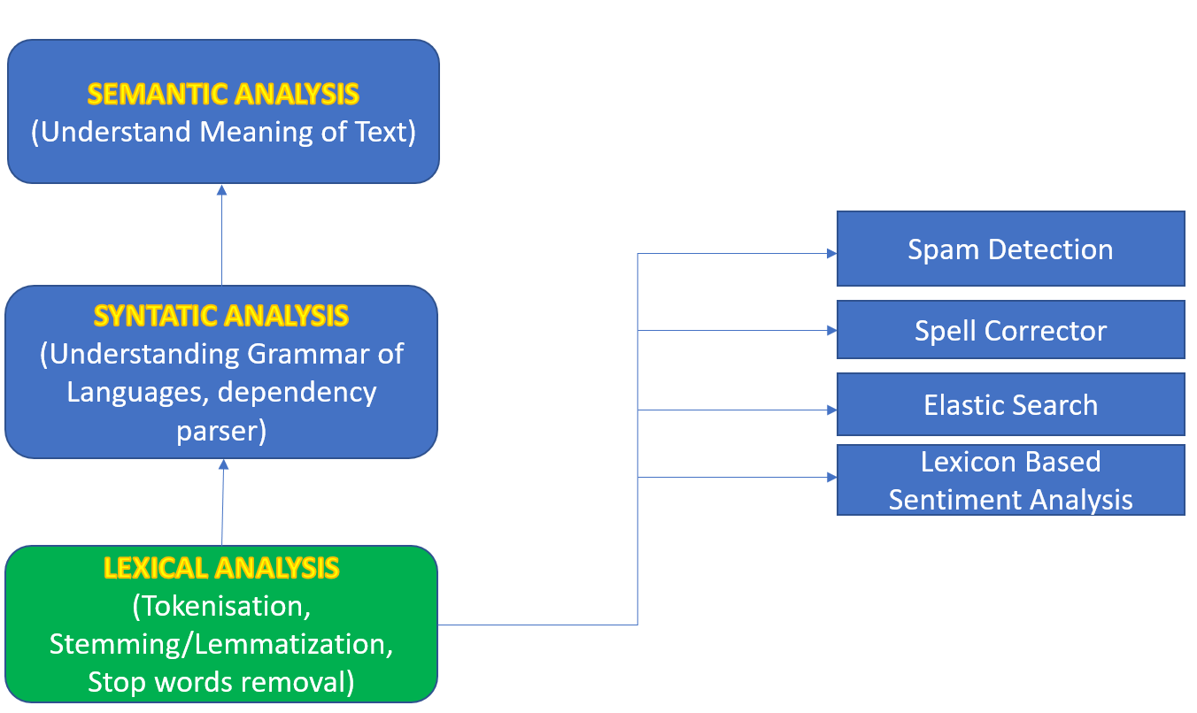
Understanding Text: Lexical analysis
Generally used as a preprocessing step
Bag of Words , TF-IDF used to create sparse matrixes
Cannot distinguish between “The cat ate its third meal” and “The third cat ate its meal”

Slide 22
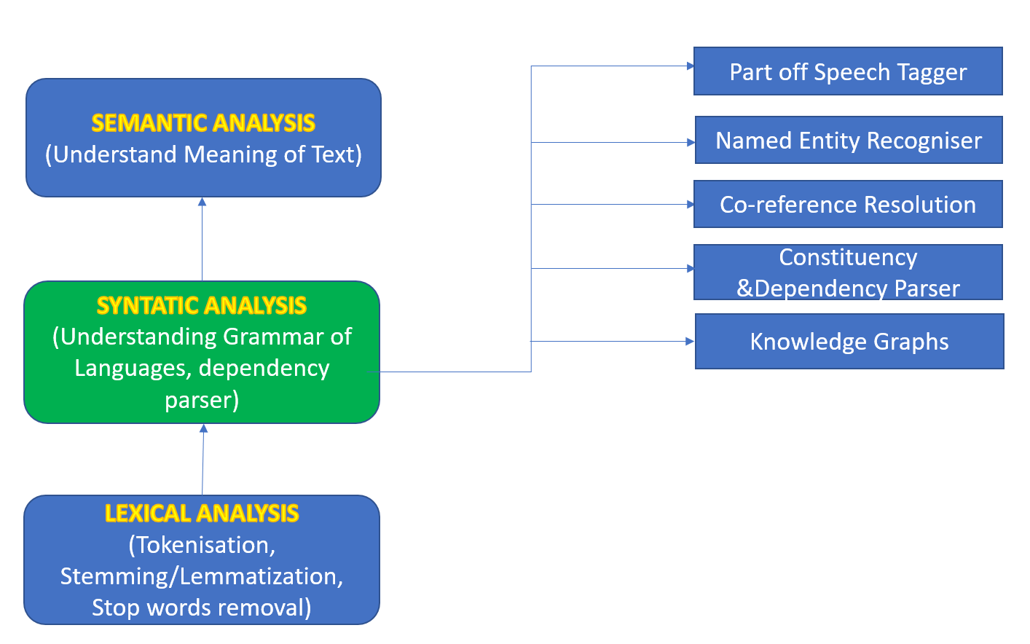
Understanding Text: SYNTATIC analysis
Understands the grammar of the language
Help in pronoun resolution, understanding the POS of a sentence
The dog chased the cat. But it escaped.” What does “it” refer too?

Slide 23
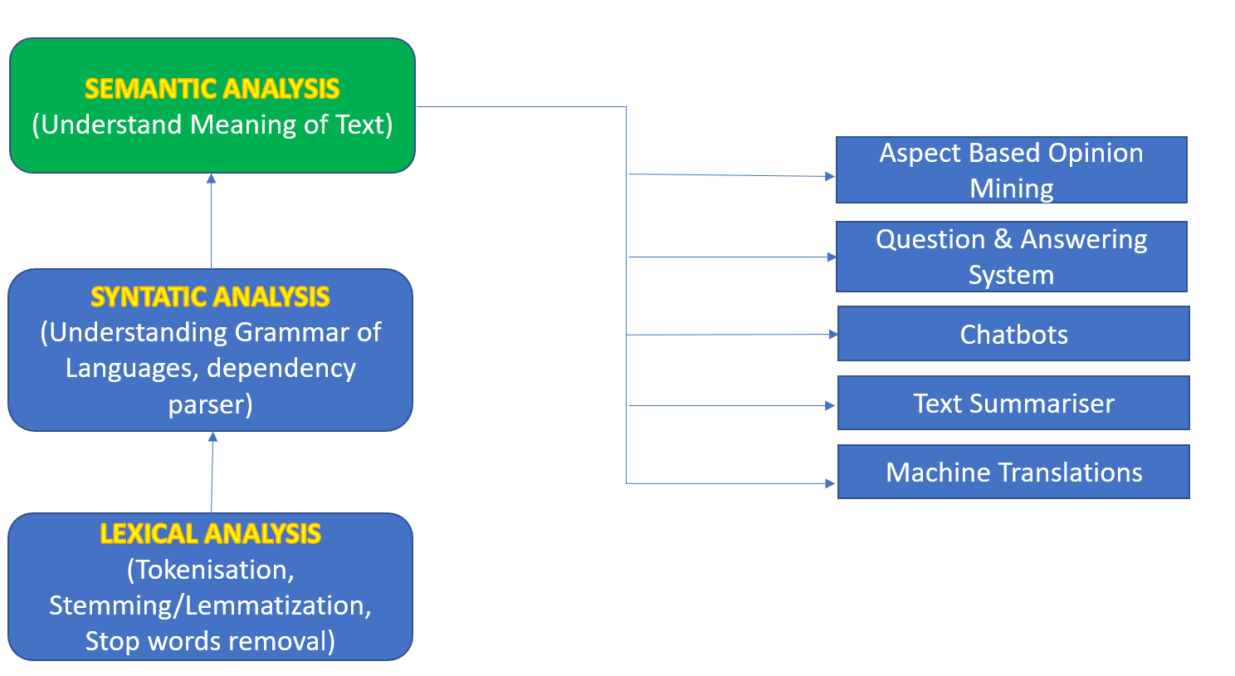
Understanding Text: Semantic analysis
“A word is known by the company it keeps”
Co-occurrence matrix is used
Creates dense embeddings – Word2Vec

Slide 24
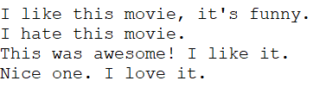
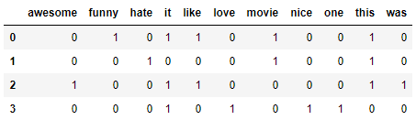
Bag of words
extracting features from text for use in modeling
describes the occurrence of words within a document
More the documents more sparse

Slide 25
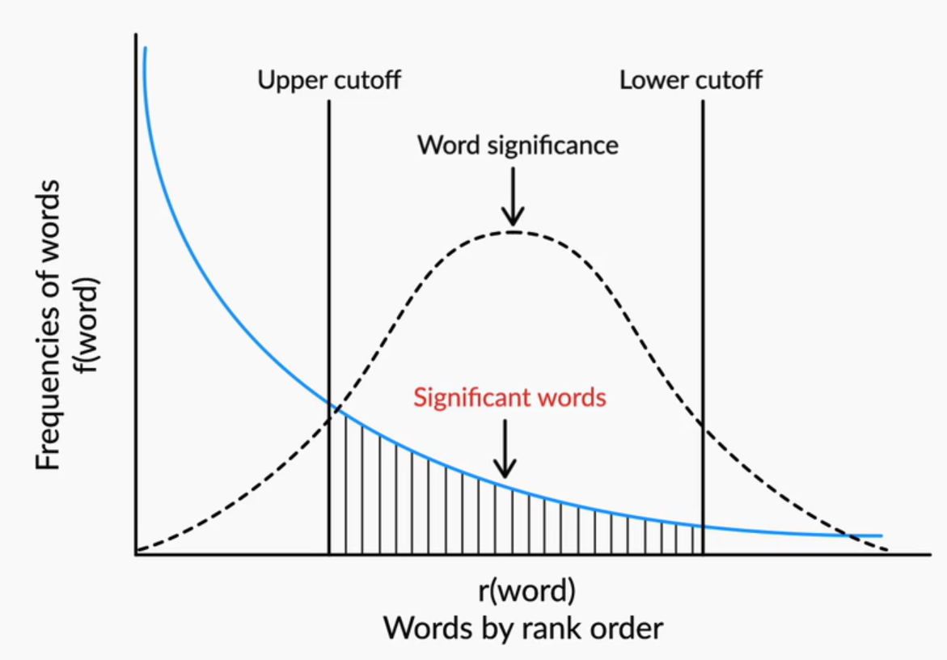
ZIPF’s LAW
Frequency of a word is inversely proportional to the rank of the word
Three kinds of words:
Highly Frequent –and, in, the (stopwords)
Significant words
Rarely occurring words
Can you think of any application where Rarely Occurring Words are important?

Slide 26
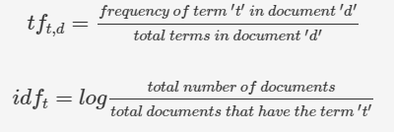
TF-IDF (Term FREQUENCY- INVERSE DOCUMENT FREQUENCY)
Takes into the account the importance of each word
Higher weights are assigned to terms that are present frequently in a document and which are rare among all documents
Low score is assigned to terms which are common across all documents

Slide 27
THE BEST WAY TO LEARN ANALYTICS IS BY DOING

Slide 28
SHOWCASE
Github/Gitlab – Own Repos, Contributions, Hobby Projects
Competitions/Hackathons – Kaggle, Crowdanalytix, Analytics Vidhya
Blog posts – Medium, Wordpress, Github
Meetups/Conferences

Slide 29
Q&A

